Slide 1
Transport, pollution and climate change 18 June 2022 Citizens’ Jury, Oxford Brenda Boardman, Emeritus Fellow
Notes:
Several context issues
General picture, exciting changes, not all clear, well described. Evolving.
University and CoHSAT
Offer information and perspectives rather than proposing solutions

Slide 2
Which do you want most?
Cleaner air, safer streets, more active travel (cycling and walking)
Or
Existing routes and travel patterns, no constraints on car use
The choice is yours
Notes:
Choice of benefits to us AND society
Vs inconvenience to us as individuals

Slide 3
Oxford’s transport emissions and targets
NO₂ - nitrogen dioxide from petrol and diesel vehicle exhausts
air quality improving, but illegal levels in the City
Exceeds 40µg/m³ annual average in 6 locations (eg Cutteslowe)
Proposed limit of 30µg/m³ by 2025 – ambitious
60% reduction during lockdown
PM₁₀ and PM_{2.5} - particulates from transport (tyres and brakes), woodstoves (wrong wood), agriculture
Not declining even during lockdown, but legal
Both bad for health – no safe levels
CO₂ - carbon dioxide: from fuel used, including electricity
UK Act: net zero carbon emissions by 2050
Notes:
City
Cant achieve 40 but want 30 in 3 years time
Direct Health for first two, indirect for third
Diesel cars by far the worst, buses next worst
Cutteslowe one of the 6
Nox and PM bad for health, but co2 bad for the climate.
Transport contributed a substantial portion of these air pollutants to the UK’s domestic total in 2019:
34% of NOx emissions
13% of PM2.5 emissions
11% of PM10 emissions

Slide 4
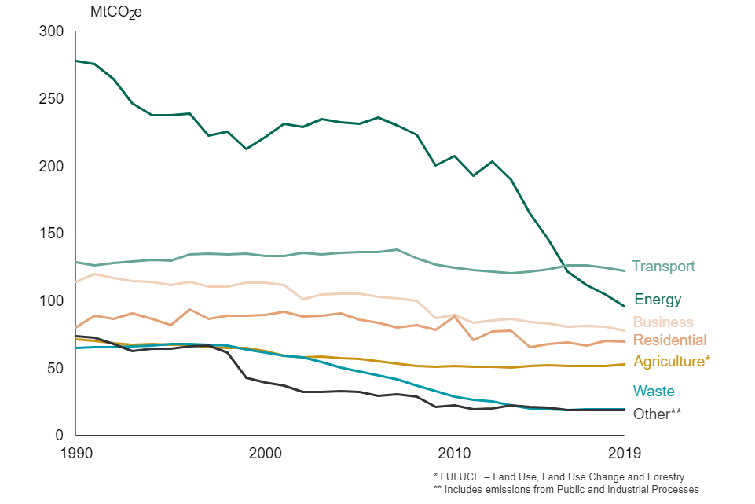
Transport: 27% of UK GHG emissions, 2019
Notes:
https://www.gov.uk/government/statistics/transport-and-environment-statistics-autumn-2021/transport-and-environment-statistics-autumn-2021
Fig 1
Now the biggest.

Slide 5
Notes:
https://publications.parliament.uk/pa/cm201213/cmselect/cmtran/239/23904.htm 2012
https://www.gov.uk/government/statistics/transport-and-environment-statistics-autumn-2021/transport-and-environment-statistics-autumn-2021
Transport = 27% of UK CO2e emissions
By 2019: cars and taxis 56%, HGV 16%, Vans 15% (up from 12%) buses still 4% = in total 91% from road transport

Slide 6
Electric vehicles and carbon dioxide (CO₂)
Electricity
CO₂ emissions count at the power station
Electric vehicles
No CO₂ emissions from an electric vehicle
They are zero emission
So electric vehicles can go into a zero emission zone
ICE – internal combustion engine
Emissions from petrol and diesel count as transport
Includes hybrids
Particulates – high, because EV are heavy

Slide 7
Résumé
Make Oxford a healthier, less polluted City
Reduce cars, less congestion
EV a help, but fewer cars
Less cars = less need for bus lanes
More space for cycle paths and wider pavements
Faster buses, better service
Healthier people, more exercise
Healthier planet, less CO₂, less NO₂, less PM₁₀ and PM_{2.5}
Notes:
3 messages, fact based.

Slide 8
Thank you
Brenda.Boardman@ouce.ox.ac.uk
Coalition for Healthy Streets and Active Travel (CoHSAT)
Low Carbon Oxford North

