Slide 1
Street Voice: Citizen’s Jury
Luke Marion, Interim Managing Director
18 June 2022

Slide 2
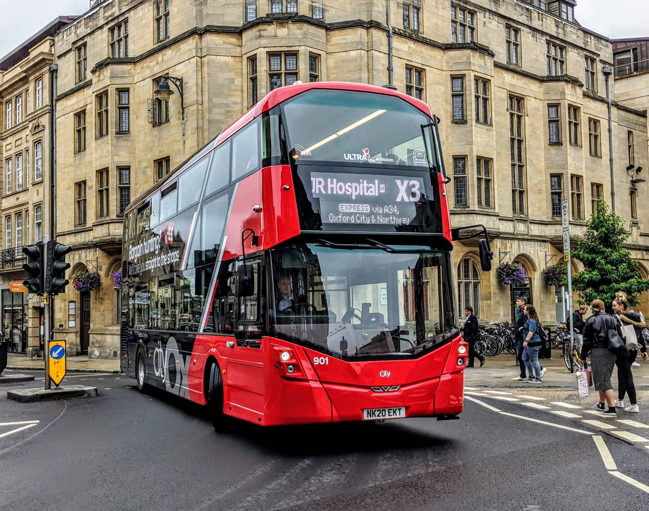
“How can we travel where we need to in Oxford in a way that’s good for health and the climate?”
…Buses need to play a huge part!

Slide 3
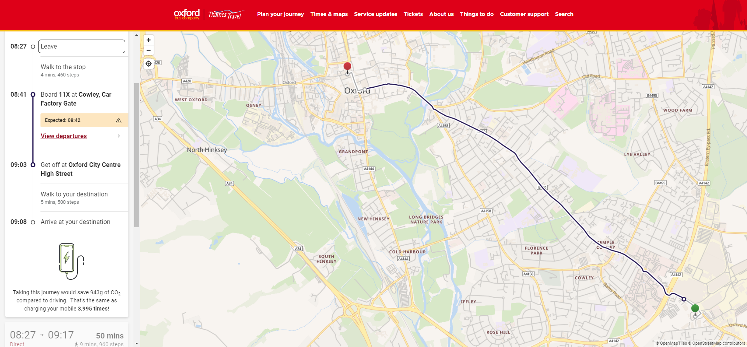
Buses are great for physical health!
A bus journey is an active travel journey! Research has found that people who commute by bus or train typically accumulate 20-28 minutes more physical activity per day than those who don’t.
Public Health England recommends 30 minutes of moderate activity per day, 5 times per week for UK adults. However 1/3rd of adults don’t manage this.
We’ve incorporated step count estimates in our journey planners to help to emphasize this

Slide 4
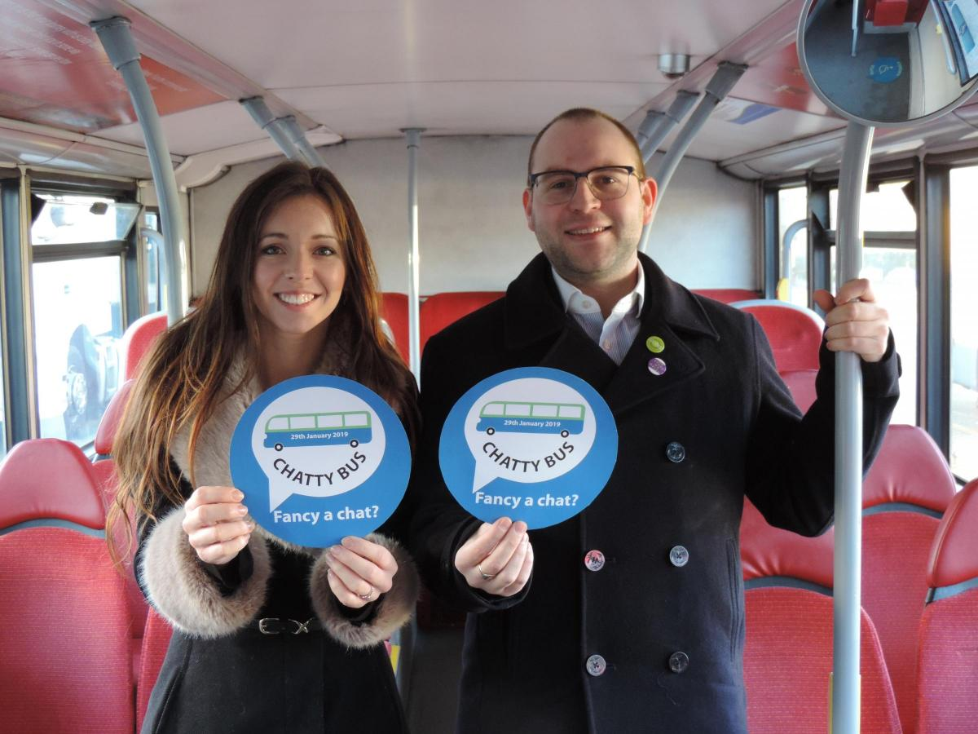
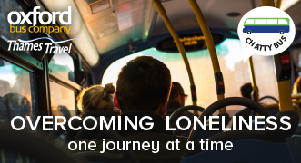
Buses are also great for mental health!
More than 13% of people in the UK feel lonely every day, and loneliness can be as bad for your health as smoking 15 cigarettes per day.
Research has found that loneliness and social isolation increases risk of mortality among UK adults by 29%.
Buses can be a powerful tool in tackling loneliness. A third of people in the UK have chosen to take the bus in order to have some human contact, and 37% of bus users say that when travelling by bus they have spoken to someone they’ve just met. Two thirds of bus users say that they think buses create strong community ties.
We have a “chatty bus” initiative to try to encourage people who may be feeling lonely to try the bus and to have a chat with us, and with others.

Slide 5
Buses are good for the climate – and we have big plans to make them even better….
Using the bus, even a diesel bus, saves lots of CO2 compared to driving!
Even if you drive in an electric car, currently there are huge amounts of CO2 produced in the manufacturing and eventual disposal of that vehicle, meaning that full lifecycle emissions of electric cars are only marginally below those of traditional petrol / diesel cars.
The incremental CO2 generated by every additional journey on the network is very small.
We have bid for, and won funding of £33.8m from government to bring 159 electric buses to the streets of Oxford from 2023. The total cost of this scheme is over £80m, with more than £40m needing to be invested by bus operators.
If successful we plan to buy all our electricity from local renewable sources.
However, the scheme is dependent on measures being introduced by Oxfordshire County Council to speed buses up by 10% compared to 2019 levels.

Slide 6
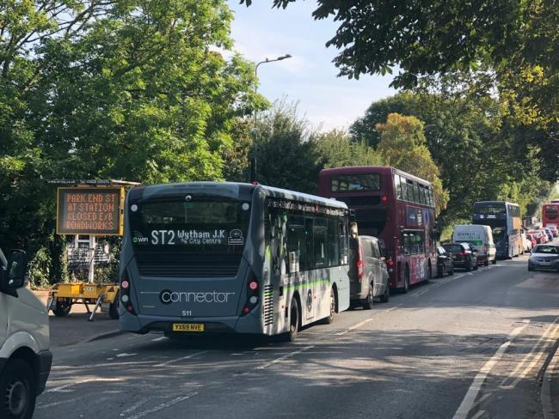
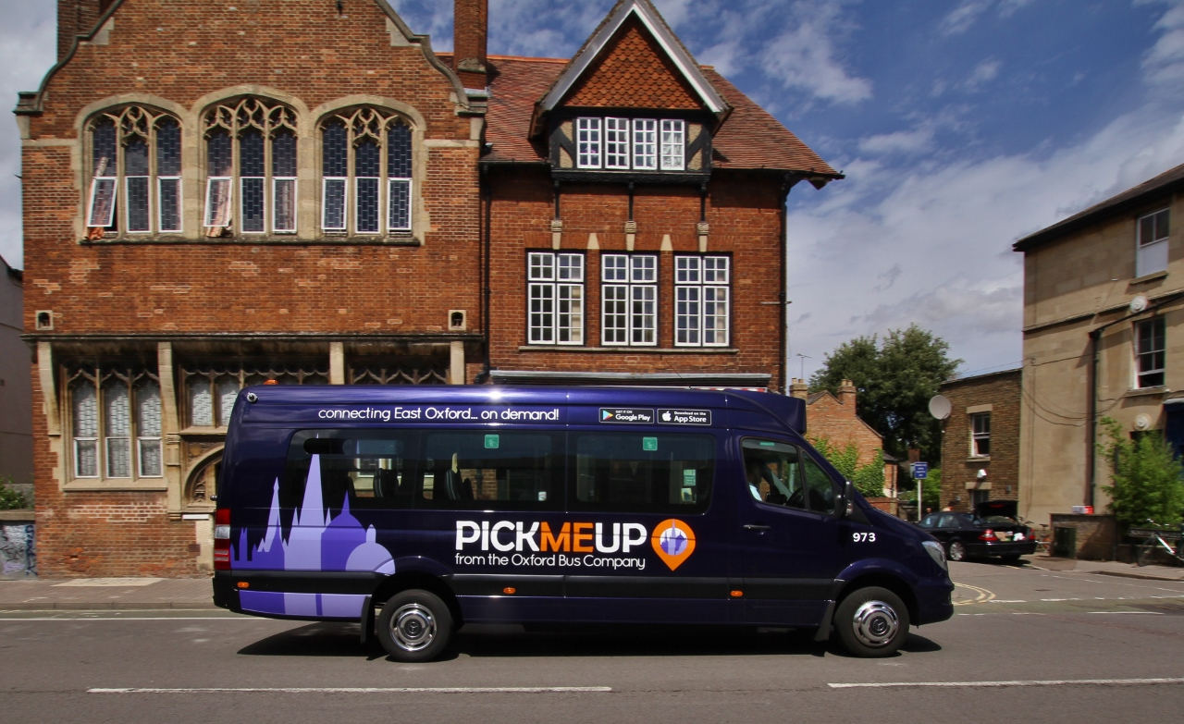
However…buses in Oxford are not as good at the moment as they should be
Buses in Oxford are slow, and are getting slower as traffic congestion increases. This has been happening gradually for years, but recently there has been a massive acceleration of congestion on bus routes due to the effects of LTNs.
This means buses are not as attractive as they could be compared to private cars and that bus fares are higher than they would need to be if buses were faster: time = money!
OCC has plans to change this, with a workplace parking levy and 6 additional bus gates planned. However, the bus elements of this plan keep being delayed, while other parts of the jigsaw are implemented that make the problem significantly worse (eg LTNs, 20mph zones).
Making orbital journeys around the city by bus is difficult and it’s often best to change in the city centre to make these journeys. Changing buses in the city centre is often quite time-inefficient due to large amounts of pedestrianized streets, and can be hard / impossible for those with limited mobility.
We previously tried to implement a demand responsive bus service “PickMeUp” to address these issues. This was supported well by business and by customers, but was not supported by the County Council and therefore ceased in 2020 when the pandemic began. We think this should return as a key part of Oxford’s transport mix – but this will need funding.

Slide 7
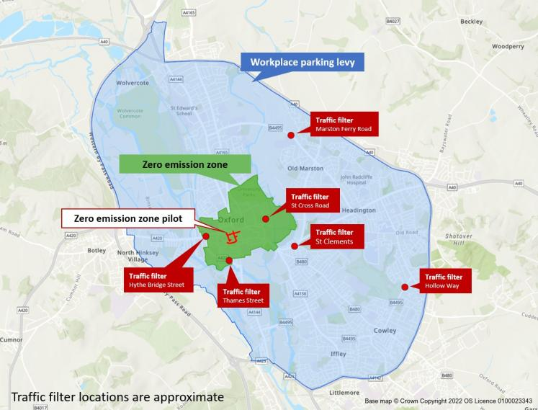
So in summary….
Buses are a great way to travel in a healthy, community focused and environmentally friendly way.
We have a “once in a generation” opportunity to make Oxford’s buses faster, cleaner and greener. We support the County Council’s plans to restrain car use in the city and to implement more bus priority measures, and are already investing money to deliver on our part of the bargain.
However, the funding we have gained is at risk if we don’t crack on with these plans, and therefore we need public pressure on the County Council to speed up the implementation, and not to implement parts of the jigsaw piecemeal. As things stand, buses in the city are getting worse rapidly and this erodes public trust that the plans will work. We need your support to ensure the County Council understands this.
The planned workplace parking levy will allow funding to be raised to support bus routes that are not “commercially viable” in their own right – which is great! This should be targeted to ensure buses are as accessible and inclusive as they should be – for example bringing back a “PickMeUp” style service. We need your help to ensure the County Council recognizes what they should spend this money on to deliver the most benefit for residents, businesses and visitors.

