Slide 1
Travel to Oxford: “Behind the Acronyms” John Disley
Head of Transport Policy

Slide 3
LTCP background
The Local Transport and Connectivity Plan (LTCP) is Oxfordshire’s statutory Local Transport Plan. It outlines our long term vision for transport in the county and the policies required to deliver this.
It replaces the existing Local Transport Plan, LTP4, adopted in 2016. The LTCP is required to reflect changes to policy and funding since 2016 and account for new priorities such as decarbonisation.
The LTCP also represents an opportunity to adopt and implement a new way of thinking, essential to help deal with the climate emergency.
Notes:
This is our 5th LTP
A plan for the whole county – want everyone to think about how they travel
LTCP will be used to decide how we manage transport and the types of schemes we (or other transport organisations) implement.

Slide 4
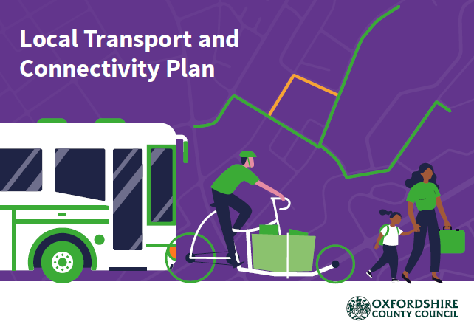
LTCP development
We have developed and consulting upon the LTCP in 3 stages:
Stage 1 – topic paper engagement
Stage 2 – vision document development Stage 3 – development of the LTCP and supporting documents
This approach has allowed for ongoing public feedback, alongside input for an ongoing steering group with a wide range of representatives.
The LTCP has also been informed by a wide-ranging evidence base.
Notes:
The evidence we have taken into account includes data about:
Car use and congestion
Public transport use, affordability and reliability
Walking and cycling levels
Road safety
Air quality
Freight movement
Deprivation and health
Population and demographics

Slide 5
LTCP vision
The vision outlines a clear long-term ambition for transport in the county and underpins the policies in the document.
“Our Local Transport and Connectivity Plan vision is for an inclusive and safe net-zero Oxfordshire transport system that enables all parts of the county to thrive.
It will tackle inequality, be better for health, wellbeing and social inclusivity and have zero road fatalities or life-changing injuries. It will also enhance our natural and historic environment and enable the county to be one of the world’s leading innovation economies.
Our plan sets out to achieve this by reducing the need to travel and private car use through making walking, cycling, public and shared transport the natural first choice.”

Slide 6
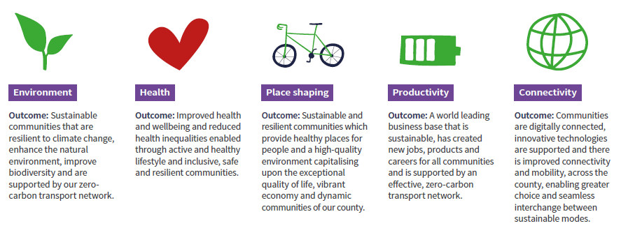
LTCP key themes
In support of the vision we have identified six key themes. These are the specific areas we are seeking to transform through implementation of the vision.
Inclusivity
Outcome: Barriers to access are removed and all communities are supported by our inclusive transport system to play a full role in society and have independence, choice and control.
Notes:
I won’t read all of these. One key point is that these are very consistent across all Oxfordshire planning documents

Slide 7
LTCP targets
In order to achieve and track delivery of the vision and key themes we have identified a set of headline targets.
By 2030 our target is to:
Replace or remove 1 out of every 4 current car trips in Oxfordshire
Increase the number of cycle trips in Oxfordshire from 600,000 to 1 million cycle trips per week
Reduce road fatalities or life changing injuries by 50%
By 2040 our targets are to:
Deliver a net-zero transport network
Replace or remove an additional 1 out of 3 car trips in Oxfordshire
By 2050 our target is to:
Deliver a transport network that contributes to a climate positive future
Have zero, or as close as possible, road fatalities or life-changing injuries
Notes:
Targets are an ambition which has been set – we do need to work through about how we achieve and by when

Slide 8
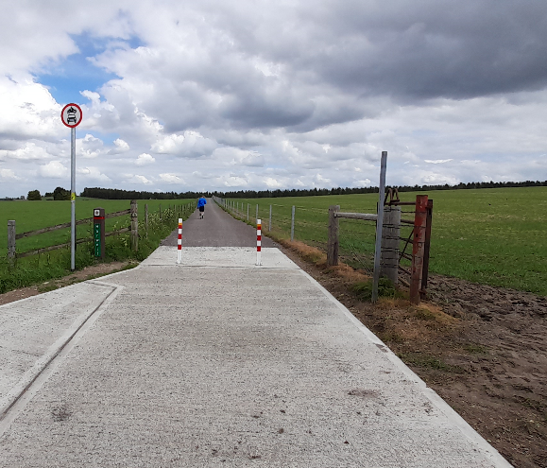
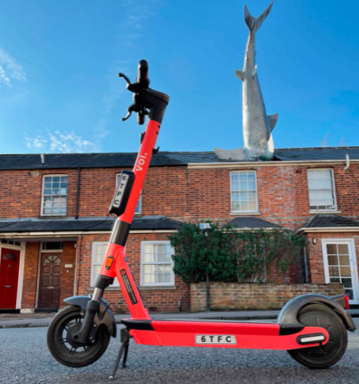
LTCP policies
Our transport policies will be used to influence and inform how we manage transport and the types of schemes we implement.
The policies explain the new approaches and measures that we will be taking to make the vision and targets achievable.
The policy areas are summarised below:
Notes:
Chosen some policy areas on the following slides that will require joint working with yourselves to deliver

Slide 9
Most recent LTCP consultation
Between January 2022 and March 2022, we consulted on the LTCP and supporting strategies
In total 1,178 responses to the consultation were received.
Overall, there was support for the vision (76% support), key themes (74% support) and targets (67% agree).
There was also support for the policies identified, with 9 of the 12 policy areas averaging over 70% support.
The only policy that was not supported was Unmanned Aerial Vehicles (31% support vs 36% oppose).
Following the feedback received in the consultation a number of key changes and improvements were made to the Plan, including (for example) adopting ‘Vision Zero’. Part 1 of the Plan was approved by the Council’s Cabinet this week

Slide 10
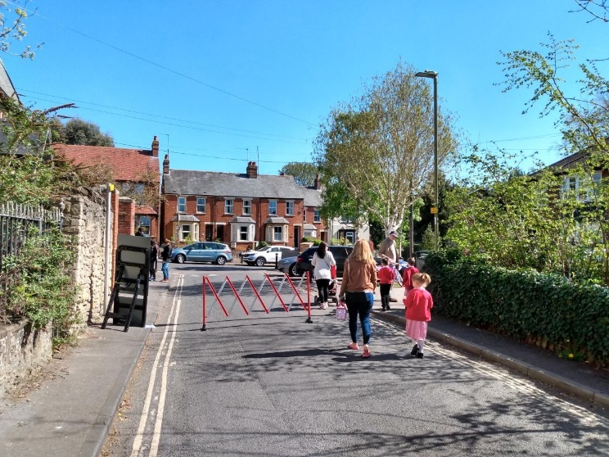
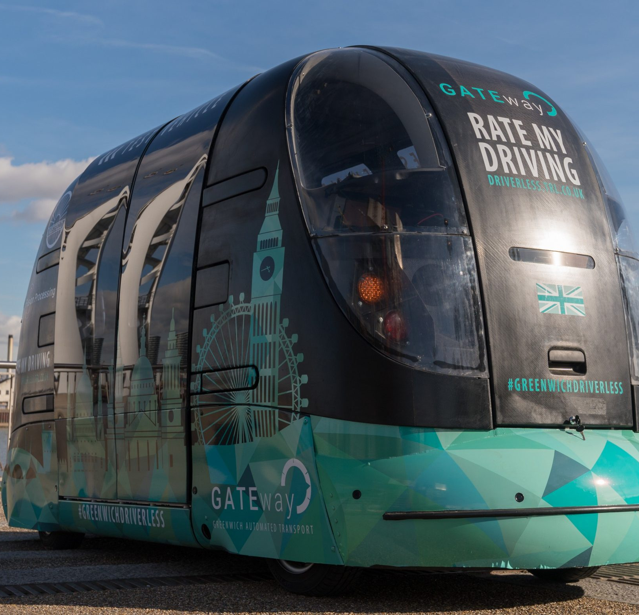
LTCP supporting strategies
Alongside the main LTCP document we have published supporting strategies for:
Freight and Logistics
Active Travel
Innovation
These build on the LTCP principles and provide more detail about complex topics.
Supporting Strategies are also being developed to cover Bus and Rail. These will be taken forward in the second stage of LTCP
Notes:
One theme we have to work through is tensions and trade-offs – so we can’t do everything everywhere to the highest standards for public transport and Active Travel for example – especially where road space is limited. We have to make choices and compromises in some areas

Slide 11
LTCP area strategies
The LTCP will also be supported by a set of more detailed place based area and corridor strategies.
These will be developed as a ‘part 2’ of the LTCP in 2022.
The strategies will outline how the LTCP vision and outcomes are delivered in locations across the county.
The Central Oxfordshire Travel Strategy (COTS) will be the first of these strategies and will define how the LTCP vision will be delivered in Oxford and the surrounding area.
Notes:
This will really get into the meat of it. We are working on the programme and milestones to make this more visible.

Slide 12
Core transport schemes for central Oxfordshire
Traffic filters: points on a road through which only certain types of traffic are allowed to pass, similar to Oxford High Street bus gate. Some exempt vehicles will be able to pass through e.g. buses, taxis, emergency services - exact list to be decided. Traffic filters will help reduce bus journey times.
Workplace parking levy: An annual charge paid by employers with 11 or more commuter car parking spaces they provide for their staff. Visitor, customer and blue badge holder parking are not included. Revenue raised from the levy will be used to improve public transport in the city.
Zero emission zone (ZEZ): an area where vehicles that are fully zero emission can be driven free of charge. All petrol and diesel vehicles, including hybrids, will incur a daily charge unless exempt. Funds raised will be used to support the transition to zero emission transport in the city.
Notes:
This is a package – along with other measures – which works together. It’s another example of decision making and how we take into account views. It will be up for consultation and debate but at the same time we cannot afford to get into ‘cherry picking’

Slide 13
Core Schemes Visualised
Notes:
May not end up exactly like this and clearly devil will be in detail

Slide 14
Benefits
Tackles post-COVID decline in bus network
Faster and more reliable buses
New and improved bus routes
Enables investment in zero emission buses (e.g. ZEBRA)
Mode shift: car bus
Reduces transport emissions, improving local air quality and tackling climate change
Reduces traffic noise
Creates opportunities for pedestrianisation and improving public spaces
Enables reallocation of road space from motor vehicles to cyclists & pedestrians
Reduced traffic flows = safer, more comfortable roads for cyclists & pedestrians
Mode shift: car cycle & walk
Generates locally-controlled income, for local transport priorities

Slide 15
Thanks for listening!
Any Questions?

