Slide 1
Street Voice Citizens’ Jury 26 June 2022
Presentation by Richard Parnham,
Reconnecting Oxford

Slide 2
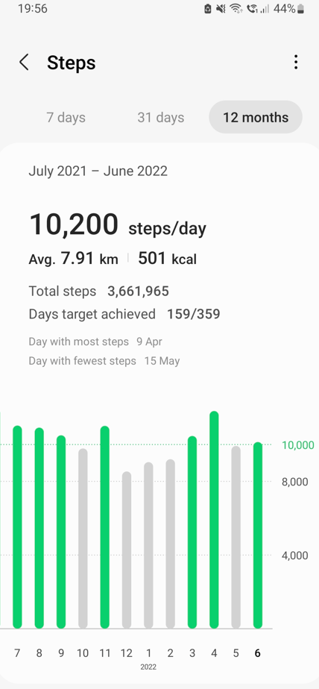
About me…
Moved to Oxford three years ago – have an outsider’s perspective of what’s “normal”.
Legal trade journalist by background, now a researcher specialising in evidence-based policy.
Not a “petrol head”.
Keen (dog) walker - active travel fan.

Slide 3
Question: “How can we travel where we need in Oxford in a way that’s good for health and climate”?
My response:
“Remove the new LTNs in Oxford, because they produce worse health and climate outcomes.”
.

Slide 4
Common criticisms of LTNs – mostly justified
LTNs displace traffic from already-quiet side streets onto busy main roads, further increasing traffic and pollution on these main roads.
LTN traffic displacement onto main roads makes bus services slower and less reliable.
LTNs do not increase active travel - walking and cycling.

Slide 5
Evidence from Oxford
Sources used:
Oxfordshire County Council: Emergency Active Travel Tranche 1: Cowley LTN Evaluation report (24 January 2022)
Oxford City Council Air quality annual status reports, 2020 – 2021 (June 2021 and June 2021)
Various freedom of information requests, Oxfordshire County Council and Oxford City Council. (Available at www.whatdotheyknow.com/user/richard_parnham)tatus reports

Slide 6
Do LTNs increase traffic on Oxford’s main roads? Overall - yes, they do.
Month | LTN change 2019 – 2021 | Comparator area change 2019 - 2021
February | 69.4% | 61%
March (LTNs installed March 2021) | 82.1% | 69%
April | 100.4% | 84%
May | 102.6% | 92%
June | 103.2% | 95%
July | 109.5% | 98%
August | 107.4% | 97%
September | 106.8% | 96%
October | 106.0% | 93%
November | 102.3% | 90%
LTN roads: Oxford Road, Iffley Road, Donnington Bridge Road, Hollow Way, Rose Hill
Comparator roads: Banbury Road, Woodstock road, A420 West, Headley Way
Source: www.whatdotheyknow.com/request/emergency_active_travel_tranche_2#incoming-2040001
Notes:
“we might cautiously deduce that 3.1% of additional traffic on these roads is generated via the LTNs. This analysis is for overall traffic flows on LTN boundary roads; however, traffic flow changes are not consistent across all LTN boundary roads or during all times (peak times are likely to be more severely impacted). While traffic levels have remained below 2019 levels on Henley Ave and Church Cowley Rd, from March through November, traffic levels on Hollow Way, Rose Hill Rd and Cowley Rd were between 105.4% and 107.5% of 2019 levels. It is worth noting, however, that even where traffic is lower than 2019 levels, it is still comparatively higher than it is in control areas (though not necessarily entirely due to the LTNs, as outlined above).

Slide 7
Worst-affected LTN boundary roads % volumes of traffic in 2021, compared with 2019
Month | Oxford Road north | Hollow Way north | Rose Hill north
February | 72.5% | 84.1% | 67.0%
March (LTNs installed March 2021) | 82.2% | 87.0% | 86.1%
April | 97.4% | 103.2% | 106.4%
May | 96.1% | 117.2% | 109.9%
June | 99.6% | 107.8% | 109.9%
July | 134.4% | 109.4% | 113.1%
August | 121.7% | 105.7% | 111.8%
September | 116.0% | 107.3% | 110.7%
October | 106.3% | 100.7% | 109.8%
November | 106.3% | 113.5% | 111.0%
Source: www.whatdotheyknow.com/request/emergency_active_travel_tranche_2#incoming-2040001

Slide 8
Pollution levels (NO2) fell by less around LTNs than in comparator locations
“Using NO2 levels as a proxy for overall air pollution, air pollution in comparison sites has reduced by 17% from pre-COVID levels, while air pollution has reduced by 8% in monitoring areas on LTN boundary roads during the same time period. By applying air pollution improvements in comparison sites as a reduction factor, Cowley LTN boundary roads have experienced an average relative increase in air pollution levels of 9%.”
Specific findings – comparable (relative) increases
Iffley Road / Boundary Brook Road = up 4%
Oxford Road / Between Towns Road = up 11%
Hollow Way / Bennett Crescent = up 13%
Cowley Road / Oxford Road = up 14%
Source: Oxfordshire County Council: Emergency Active Travel Tranche 1: Cowley LTN Evaluation report, p398

Slide 9
Rolling 12-month Hollow Way NO2 pollution averages in µg/m3 Projections ONLY from March 2022, using 2019 historic data
Pollution levels on Hollow Way are on trend to breach legal limits for the first time
Sources: Oxford City Council Air quality annual status reports, 2020 – 2021, various freedom of information requests to Oxford City Council
Notes:
2019 Average: 37

Slide 10
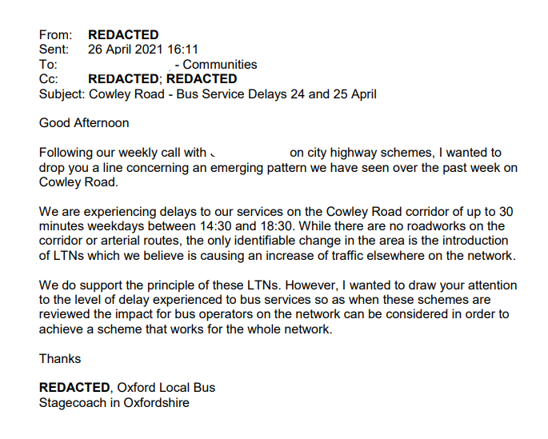
LTNs make traffic worse – and bus reliability suffers
“Once we adjust for the pre-existing difference in difference, the peak increase in PM-peak journey time since LTN implementation is 21.7% - still a significant increase”
Sources: Oxfordshire County Council: Emergency Active Travel Tranche 1: Cowley LTN Evaluation report, p396. www.whatdotheyknow.com/request/cowley_ltns_discussions_with_bus#incoming-1805046

Slide 11
Average daily walking levels within LTNs barely changed between 2019 and 2021 – and were often lower
“Overall, from March through November, pedestrian volumes within the Cowley LTNs during 2021 were 91.2% of pedestrian volumes in the same period during 2019.”
LTN roads: Rymers Lane, Long Lane, Cowley Road
Sources: Oxfordshire County Council: Emergency Active Travel Tranche 1: Cowley LTN Evaluation report, p384, www.whatdotheyknow.com/request/emergency_active_travel_tranche_2#incoming-2040001
Notes:
Comparator roads: Windmill Road, Ashhurt Way, Moreton Road, Minns Business Park

Slide 12
Average daily cycling levels within LTNs barely changed between 2019 and 2021 – and were often lower
“Overall, from March through November, cycling volumes within the Cowley LTNs during 2021 were 86.3% of cycling volumes in the same period during 2019.”
LTN roads: Rymers Lane, Long Lane, Cowley Road
Sources: Oxfordshire County Council: Emergency Active Travel Tranche 1: Cowley LTN Evaluation report, p385,
www.whatdotheyknow.com/request/emergency_active_travel_tranche_2#incoming-2040001
Notes:
Comparator roads: Windmill Road, Ashhurt Way, Moreton Road, Minns Business Park

Slide 13
“In my position, faced with your question, trying to find solutions that work for everyone affected in Oxford, my advice would be: Oxfordshire County Council should scrap the recently-introduced LTNs in Oxford. LTNs are bad for health, bad for the climate, and actively make many people’s lives worse. LTNs also DO NOT noticeably improve active travel - which one of their supposed objectives.”

Slide 14
Thank you! We live at www.reconnectingoxford.com Twitter: @ReconnectingOx

