Slide 1
Health, Equality and Transport
Citizens' Jury on transport, climate and health in Oxford
Robin Tucker, June 2022

Slide 2
Current transport is dangerous, but for the reasons most people think
UK Annual Deaths from transport-related causes (pre-Covid)
100,000 – about the same as tobacco
In Oxfordshire
26% of Adults
42% of Children
Don’t meet NHS activity guidelines
+ Transport causes 28% of UK’s climate change impact
+ Oxford’s road transport system is not working well: growing congestion for many years
10-20,000 due to transport air pollution
1750
Sources: NHS/ONS, Public Health England, DfT, WHO/UK Gov’t. * UK share of global total (1.1%)
Notes:
Sources:
1. NHS, ONS
2. Public Health England
3. DfT Road Casualty Statistics
4. Deaths due to climate change: 150,000 per year. (WHO) https://www.who.int/heli/risks/climate/climatechange/en/
UK Contribution to Global Climate Change 1.1% https://commonslibrary.parliament.uk/uk-and-global-emissions-and-temperature-trends/ (IEA data)
= 1650
Transport is 28% of UK GHG emissions (UK GHG Inventory)
= 462

Slide 3
Perceived dangers of traffic are stopping people from walking and cycling
Danger Reality
vs. Perception
Health benefits of cycling are 10-20x the risks … but for many perception outweighs the statistics
Traffic also stops walking – e.g. children driven to school because “there is too much traffic”
In reality the danger of inactivity is much bigger
Sources: DfT Road Casualty statistics (of the 1750 on previous page), DfT Attitudes survey

Slide 4
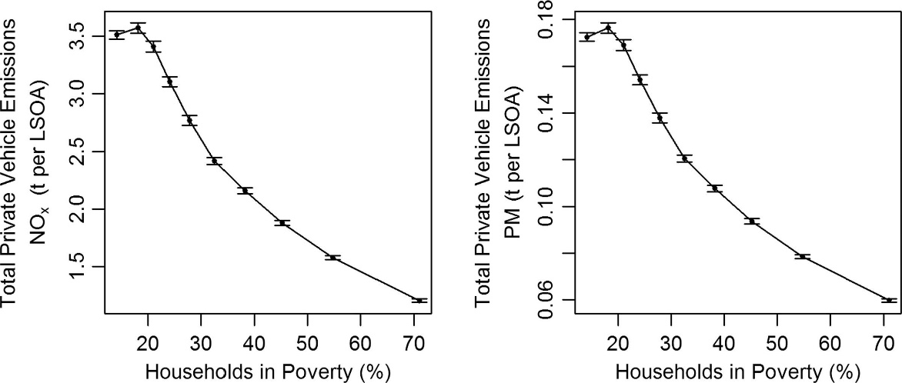
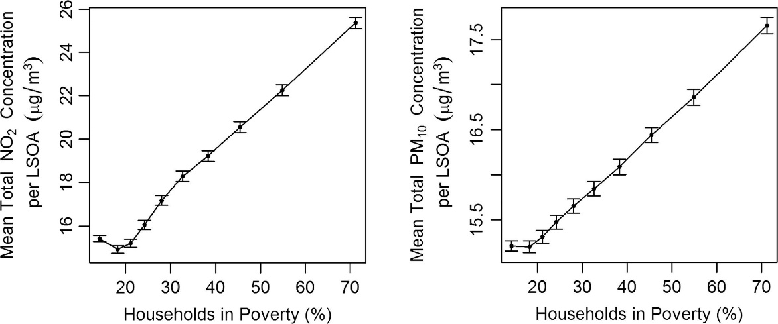
Health effects are unequal and added to by other problems in deprived areas
Nitrous Oxides Harmful Invisible gases
Particulates Tiny pieces: soot, tyres, brake pad
Wealthier people:
Own more cars & drive more Top tenth: 93% have a car/van 69% have 2+ cars/vans
Create more pollution (top charts >>)
Pollution Caused
Poorer people:
Have fewer cars Bottom tenth: 65% don’t have a car
Live where air pollution is higher (Bottom charts >>)
+ Other factors
Lower access to public transport
Lower access to green spaces
Lower access to other services (medical, shops, leisure, etc.)
Leads to
Worse health and shorter lives: 10 years difference between best and worst areas of Oxford
Pollution Consumed
Richer areas
Poorer areas
Richer areas
Poorer areas
Source: Emissions vs exposure: Increasing injustice from road traffic-related air pollution in the United Kingdom; Barnes, Chatterton, Longhurst; Transportation Research 2019. Based on 34,753 Census Areas (LSOAs)

Slide 5
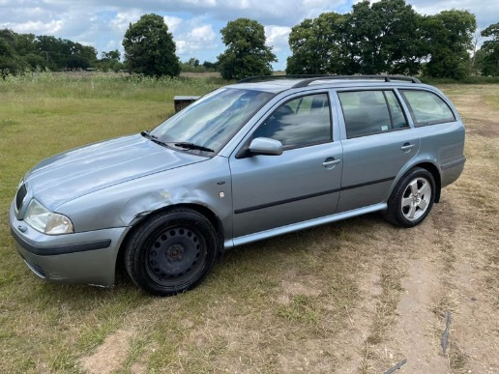
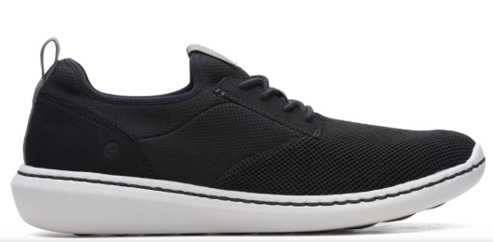
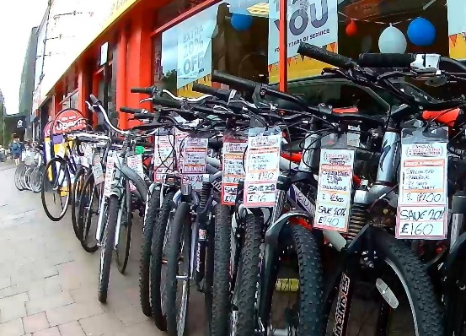
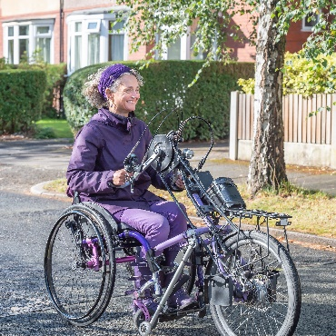
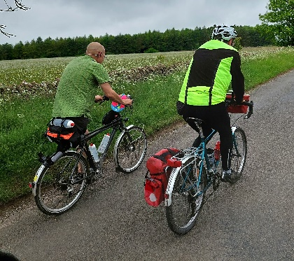
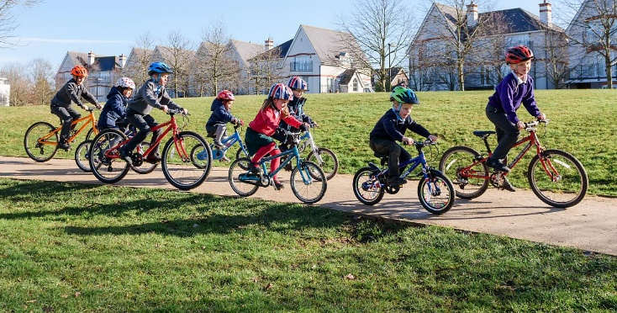
Active Travel brings health benefits to everyone
Financial – it’s cheap
Disability – enabler more than barrier
Benefits to everyone
Disabled people need to be active, and many value the independence of active travel
Active travel reduces future disability levels
Children need to develop healthy habits & independence
People with conditions (e.g. eyesight, epilepsy) who can’t drive but can walk or cycle
1/3 Oxford households without a car
Non-users benefit from lower pollution and road danger
Used car
£600 to buy
+ £2400 a year to run
Shoes £28
Used bike £96
A 65 mile ride in the Cotswolds
Sources: Cheapest used car near Oxford on Autotrader, CAP, Clarks, Cycle King, Sustrans, DfT

Slide 6
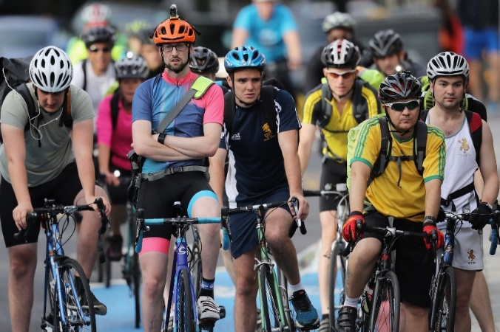
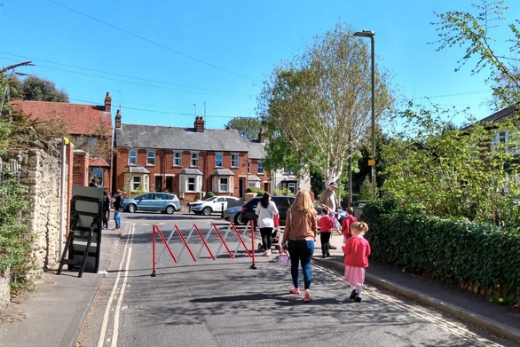
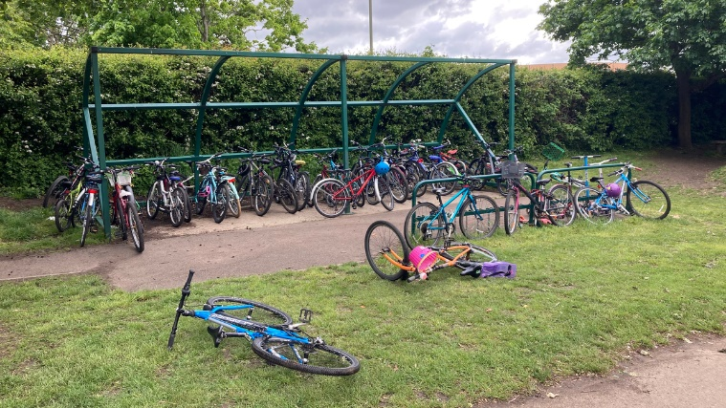
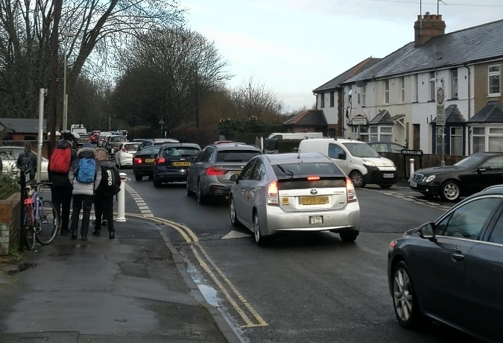
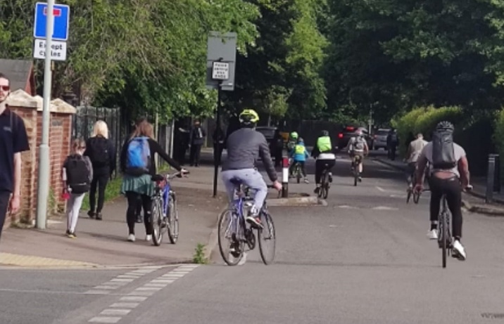
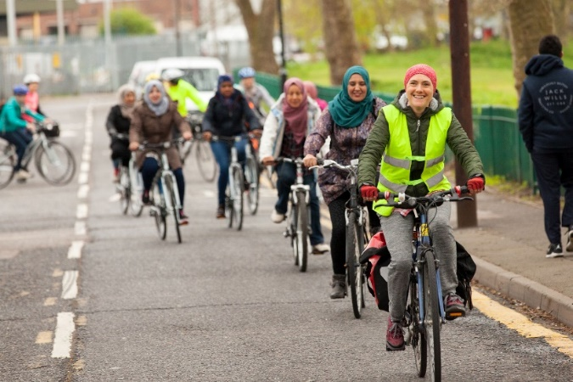
A basic principle is “You get who you design for.”
Car dominated streets
Only the brave: Mostly men, from ‘secure’ (mostly white) backgrounds.
Healthy streets
Cycling is open to women, children and people of all backgrounds.
Oxford Low Traffic Neighbourhoods have seen large increases in walking and cycling to school
Rymers Lane, Oxford – Before and after traffic filter
Cycle Sisters, a Muslim women's’ cycling group, in a Waltham Forest Low Traffic Neighbourhood
Sources: https://therantyhighwayman.blogspot.com/2018/04/you-get-who-you-design-for.html

Slide 7
The change not quite that easy…
A mix of changing the streets…
…and changing journey habits
Need to make walking, wheeling and cycling more attractive and feel safe as well as be safe
Current layouts favour cars (have since 1960/70s)
Housing at city edge
Few shops & services in short walk/cycle
Hostile roads
Narrow pavements, poor crossings
People attached to benefits of cars
Carrying people & loads
Convenience
Emotional
Social
Habits formed around car use
‘Rat runs’: worse since sat nav
‘The weekly shop’
‘The school run’

Slide 8
In my position, faced with your question, trying to find solutions that work for everyone affected in Oxford, my advice would be…
Think about changes that would allow more healthy travel in your community – particularly for short journeys.
What changes would you like to happen?
How would you like your streets to look and feel?
What are the barriers that stop people walking or cycling – are they infrastructure (the streets and traffic), functional (the journeys you need to make), emotional (feelings) or social (what other people might think or feel)?
What needs to happen to make the changes or remove the barriers?

