Slide 1
Dr. Tim Jones
Reader in Urban Mobility
Creating exceptional places for sustainable and active travel
Street Voice Citizens’ Jury | OXFORD 18 JUNE 2022
Notes:
The role of walking and cycling and electric micromobility.
Creating places for sustainable and active travel involves ensuring that walking and cycling is safe, easy and pleasurable and accommodates the broadest spectrum of society. In this talk Tim will provide insights from his research over the past decade or more on walking and cycling in the UK context and how it can be supported and promoted. He will also reflect on the role of electric micromobilities within programmes to ‘electrify infrastructure’ and consider measures that will be required to ensure sustainable and active travel modes can co-exist in harmony.

Slide 2
About me as an ‘expert’
Worked for regeneration agency | private transport consultancies | university
Interested in understanding how places can be made more healthy, sustainable and equitable.
Focus has been on the role of walking and cycling (‘active travel’)

Slide 3
About me as a person
I live in East Oxford on the border of a Low Traffic Neighbourhood.
I am a single parent living part time with my teenage daughter.
I try to reduce my impact as best I can
Transport – I walk or cycle for short journeys.
Diet – I became vegetarian age 15 and have been vegan for nearly 7 years.
I own a diesel van which I sometimes use to access social activities further afield or for transferring heavier goods.

Slide 4
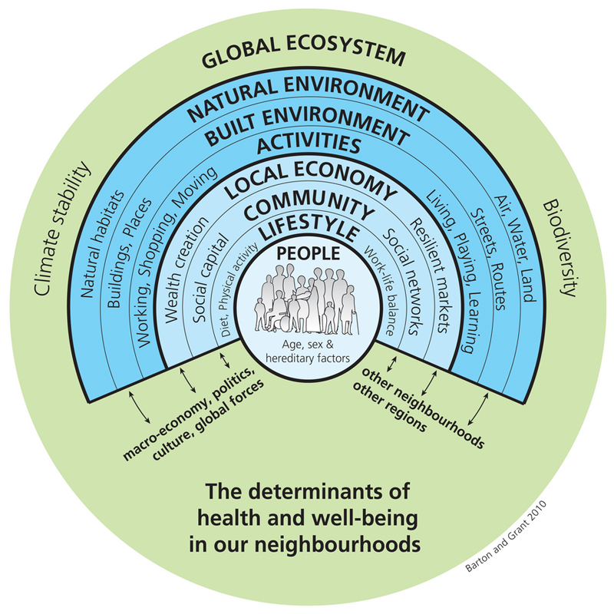
Role of the Built Environment
Triple Challenge
Ageing Society
Achieving
Sustainable & Equitable Mobility
Health and Wellbeing
Climate Change
Built environmental design supportive of walking and cycling ('active travel') could help to promote moderate physical activity, delay biological ageing and age-related conditions, and improve overall health and wellbeing.

Slide 5
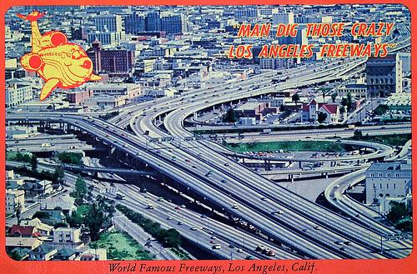
A Century of Motorisation
Massive growth in motor traffic.
Towns and cities designed around the car.
Sprawl and ‘no choice but to use car’
Demands on space
Domination of space
Road danger & hostile environment
Deterioration of public realm
Reduction in other activities
Local and global pollution
Poor health and obesity
Notes:
‹#›

Slide 6
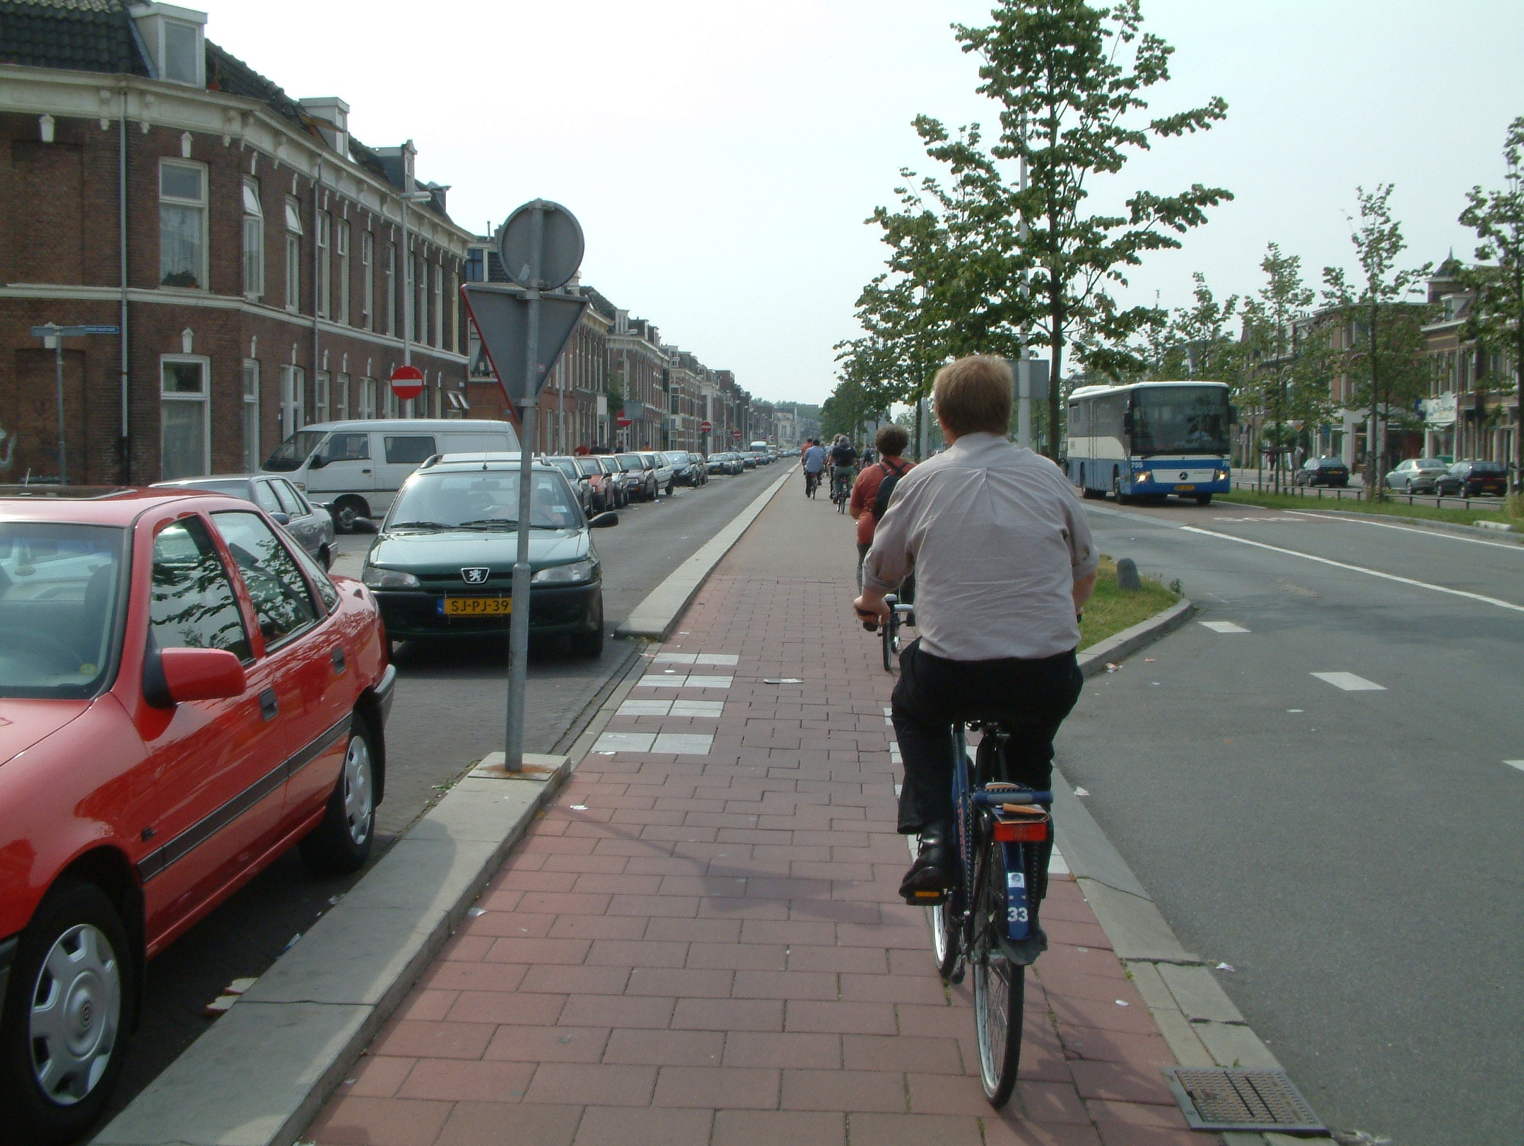
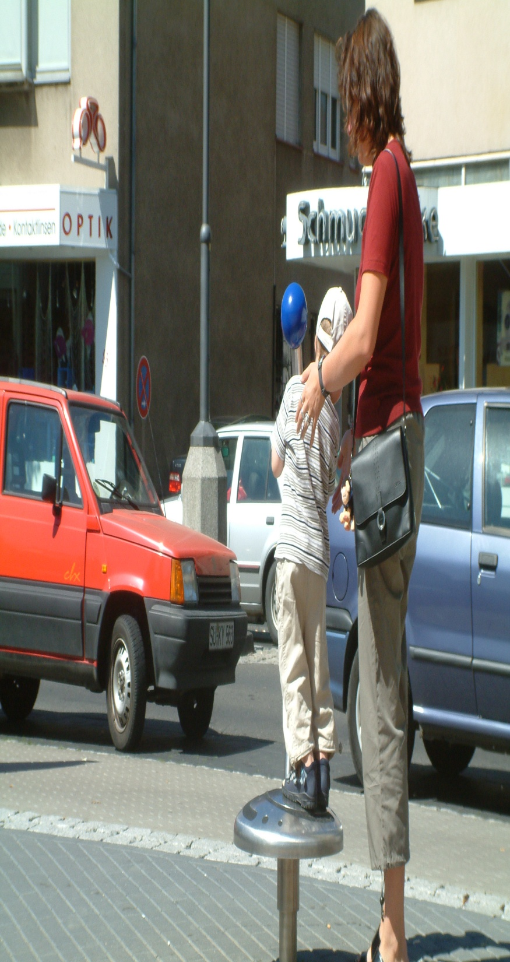
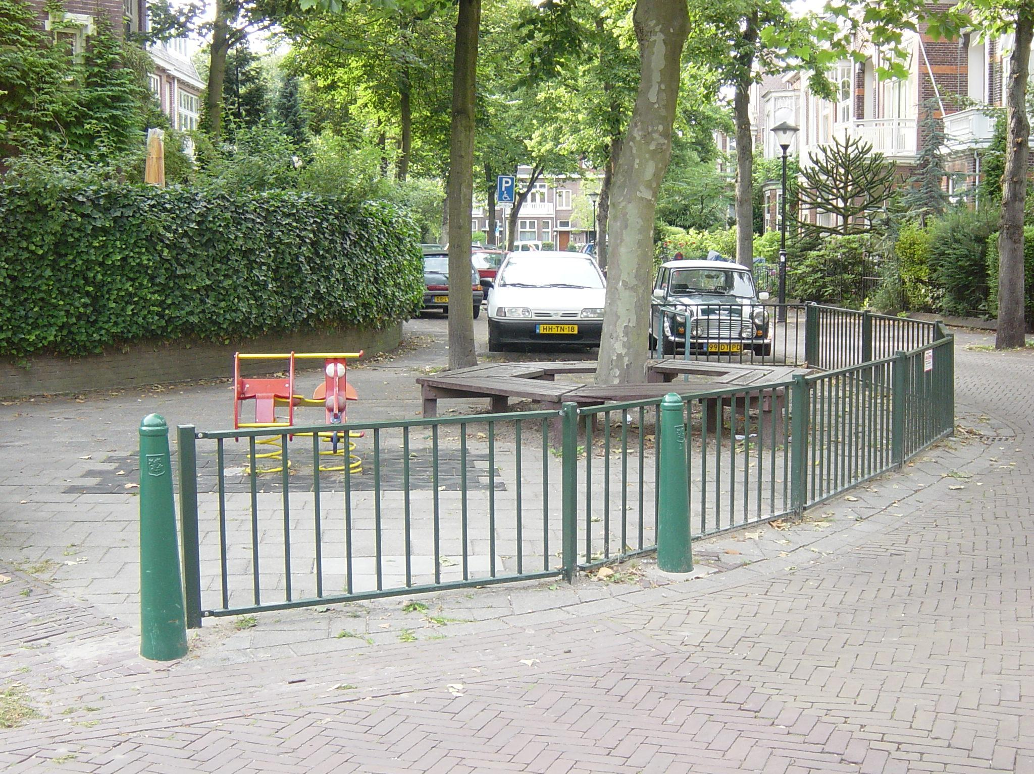
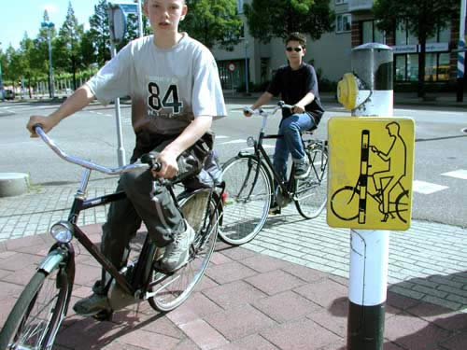
Key point 1: Support a more diverse range of people to walk and cycle for short distances. Supports child-friendly and age-friendly cities agenda.
Reallocate road space in the city to create more space for cycling and walking.
Provide dedicated walking and cycling space on busier urban roads, particularly main roads into towns and cities.
Implement age friendly streets across all residential areas by reducing through traffic and lowering traffic speeds.
Busy main distributor road accommodates high-speed bus lane, two lanes of traffic in either direction, access road and continuous cycle lane with priority over side roads.
Frankfurter Strasse, Hennef
Leeuwendaal, Delft

Slide 7
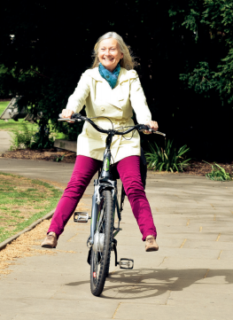
Key point 2: Support electric bike and other ‘e-mobility’
Offers the potential for more, and different types, of people to engage with cycling outdoors and reap the associated mental health benefits
Training
Try-out
Tax incentives
Tackling mis-perception
The last mile possibilities
Read our evidence here:
Jones T, Spencer B, Beale N, Leyland LA, van Reekum C , '“You can go out 14 miles away with the knowledge that you’ve got the battery to help you back if you need it!” Narratives of ranging behaviour and wellbeing in diaries of e-bike trial participants. Active Travel Studies: An Interdisciplinary Journal x (2021)
ISSN: 2732-4184 eISSN: 2732-4184
Leyland L-A, Spencer B, Beale N, Jones T, van Reekum CM (2019) The effect of cycling on cognitive function and well-being in older adults. PLoS ONE 14(2): e0211779. https://doi.org/10.1371/journal.pone.0211779
'“You can go out 14 miles away with the knowledge that you’ve got the battery to help you back if you need it!”
“I think Brian became a happier person, more positive, as a result of his [e]bike trial” Brian’s partner
Watch Brian and others talk about their experiences here: https://www.cycleboom.org/video/

Slide 8
Summary
“In my position, faced with your question, trying to find solutions that work for everyone affected in Oxford, my advice would be…”
Acknowledge the damage that unfettered use of motor vehicles is doing to our society and planet. Think about the type of city you would like to live in or your (grand)children to live in.
Be open minded and learn about what more advanced countries in Northern Europe have done to reduce the need to use a car and promote W, C & PT. People are no different there to here!
(Re)establish streets as our most important public spaces that may serve many functions such as walking, wheeling, play, lingering, meeting people. Think more broadly than streets solely for the purpose of moving and storing cars.
Support the opportunity provided by old, new and emerging forms of electric mobility. Not everyone can or wants to ride an ordinary bicycle. Recognise the huge potential to support people who wouldn’t ordinarily pedal cycle e.g. older people, people with disabilities.

Slide 9
Dr. Tim Jones
Contact me at tjones@brookes.ac.uk
Creating exceptional places for sustainable and active travel
Street Voice Citizens’ Jury | OXFORD 18 JUNE 2022
Notes:
The role of walking and cycling and electric micromobility.
Creating places for sustainable and active travel involves ensuring that walking and cycling is safe, easy and pleasurable and accommodates the broadest spectrum of society. In this talk Tim will provide insights from his research over the past decade or more on walking and cycling in the UK context and how it can be supported and promoted. He will also reflect on the role of electric micromobilities within programmes to ‘electrify infrastructure’ and consider measures that will be required to ensure sustainable and active travel modes can co-exist in harmony.

