Slide 1
Need, Intervention, Scale: input for Street Voice Citizen Jury
Prof Tim Schwanen
@TimSchwanen, tim.schwanen@ouce.ox.ac.uk

Slide 2
How can we travel where we need to in Oxford in a way that’s good for health and the climate?
What do people who live in, work in or visit Oxford need so that they can move around safely and easily?
How are people’s travel needs best balanced with the need to promote health and fairness and tackle climate change?
What can Oxfordshire County Council do to help achieve these aims?

Slide 3
Mobility needs (1)
Easily used, difficult to define & identify:
Perceived needs are often ‘wants’
Fulfilment of mobility needs is coupled: what person/group x does has consequences for what y can do
⇨ Prioritisation & trade-offs inevitable

Slide 4
Source: Nussbaum (2011, pp.33-34)

Slide 5
Mobility needs (2)
Risk that basic capabilities are compromised on streets:
Largest when (large) private cars, vans & lorries dominate the city
Smallest when walking dominates everywhere in the city

Slide 6
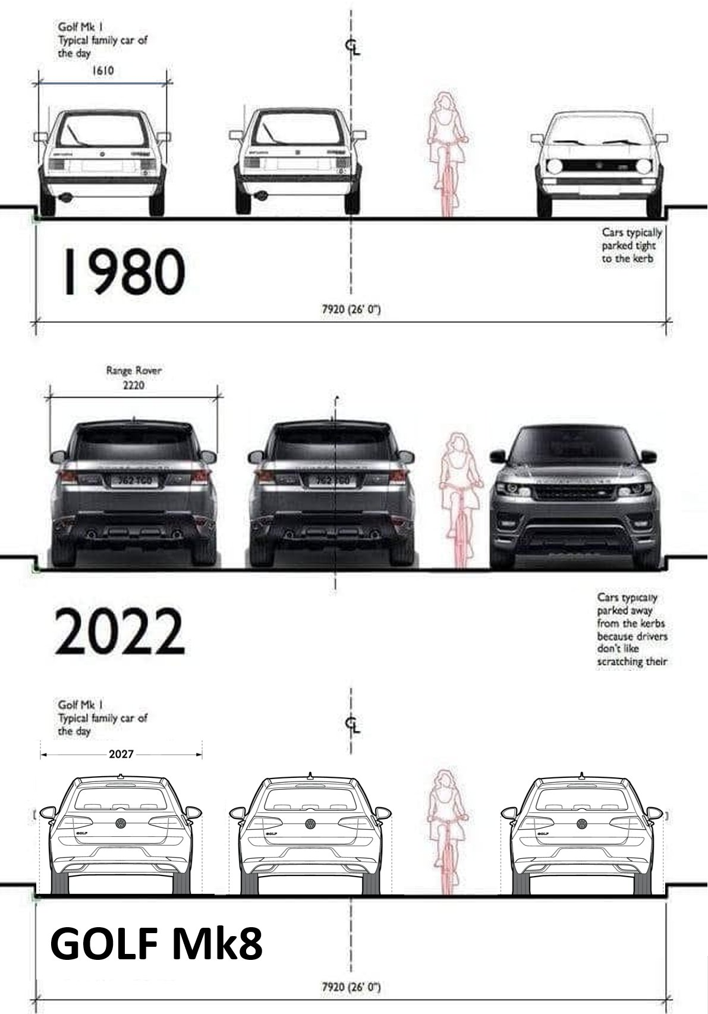
Width: +61 cm
Width: +42 cm

Slide 7
Mobility needs (2)
Risk that basic capabilities are compromised on streets:
Largest when (large) private cars, vans & lorries dominate the city
Smallest when walking dominates everywhere in the city
Not against cars, vans, lorries as such – but:
Only use them when there is no plausible alternative
Push for small, light & clean vehicles
Create local distribution centres

Slide 8
Intervention
‘Enhancing choice’ by providing alternatives is not enough to address existing problems
Bans & levies are essential – but:
‘Sticks’ must be combined with ‘carrots’
‘Carrots’ must be in place first
Participatory co-design is essential

Slide 9
Scale: the bigger picture
Don’t privilege short term – habit change takes time
Think regionally: Oxford is bigger than city within the greenbelt
LTNs, ZEZ, bus filters and workplace levy are part of a comprehensive regional strategy
Failure of LTNs puts whole strategy at risk, potentially reducing Councils’ financial resources in longer term

Slide 10
Take away messages
Many mobility needs are wants & need fulfilment influences what others can do
Bans and levies are essential but need to be mixed with enabling interventions
Focus on the bigger picture: creating a ‘new normal’ takes time, and has to be done on the regional scale

Slide 11
Need, Intervention, Scale: input for Street Voice Citizen Jury
Prof Tim Schwanen
@TimSchwanen, tim.schwanen@ouce.ox.ac.uk

